Slide 1
Nutrition Agent
CAPSTONE PROJECT
Presented By:
Vinayak Mehta – Parul Institute of Technology - CSE

Slide 2
OUTLINE
Problem Statement (Should not include solution)
Proposed System/Solution
System Development Approach (Technology Used)
Algorithm & Deployment
Result (Output Image)
Conclusion
Future Scope
References

Slide 3
Problem Statement
As individuals increasingly prioritize health and wellness, the demand for customized, dynamic nutrition guidance is growing. However, most existing tools offer static and generic diet plans that fail to accommodate users’ unique lifestyles, evolving health needs, cultural food habits, medical conditions, and allergies. Simultaneously, dieticians and nutritionists are constrained by limited scalability in offering personalized, real-time consultations to a broad population.

Slide 4
Proposed Solution
Personalized Meal Planning
Generates dynamic meal plans tailored to:
Health goals (e.g., weight loss, muscle gain)
Medical conditions (e.g., diabetes, hypertension)
Dietary preferences, cultural habits, and allergies
Smart Food Recommendations
Suggests healthy food swaps and portion adjustments based on nutritional needs.
Contextual Explanations
Uses generative AI to explain "Why this food?" in a simple, science-backed manner.
Real-Time Adaptability
Learns from user feedback and continuously updates recommendations.
IBM Cloud Integration
Leverages IBM Cloud Lite services for NLP, data storage, hosting, and APIs.

Slide 5
System Approach
System Requirements Component - Minimum Requirement
Operating System - Windows 10 / Linux / macOS
Processor (CPU) - Intel i5 or higher
RAM - 8 GB (16 GB recommended)
Storage - 10 GB free disk space
Internet - Stable connection for API/IBM Cloud calls 2. IBM Services Required: IBM Watson NLP - For intent recognition and text understanding IBM Watson Assistant - To drive conversational dialogue IBM Cloud Object Storage - Storing user data, meal plans, and media IBM Cloud Foundry / Functions - Hosting backend logic and APIs

Slide 6
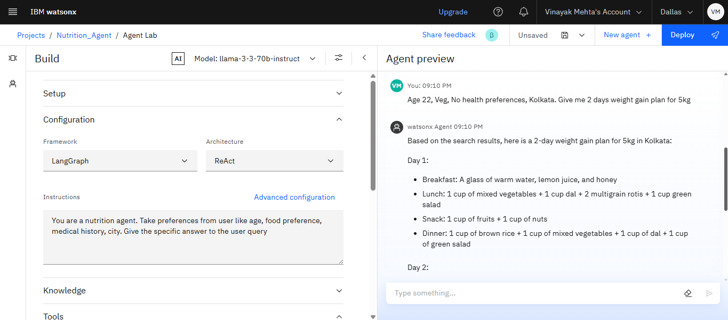
Result

Slide 7
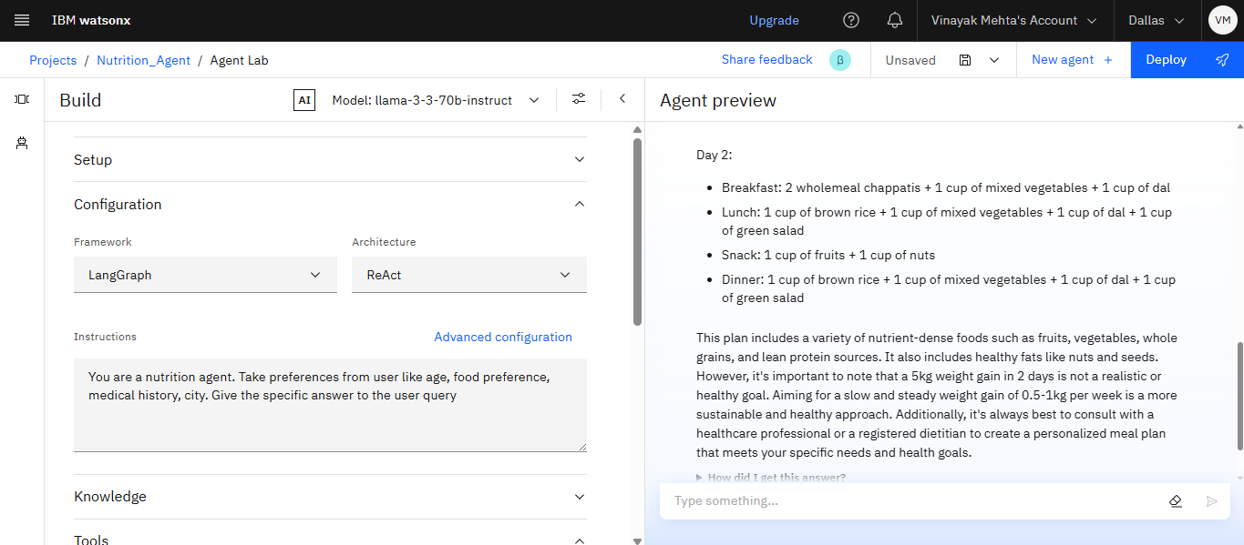
Result

Slide 8
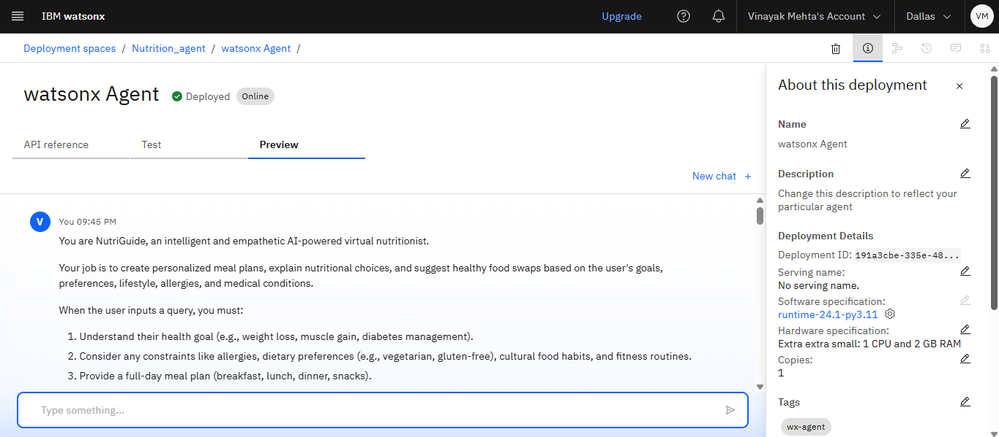
Result

Slide 9
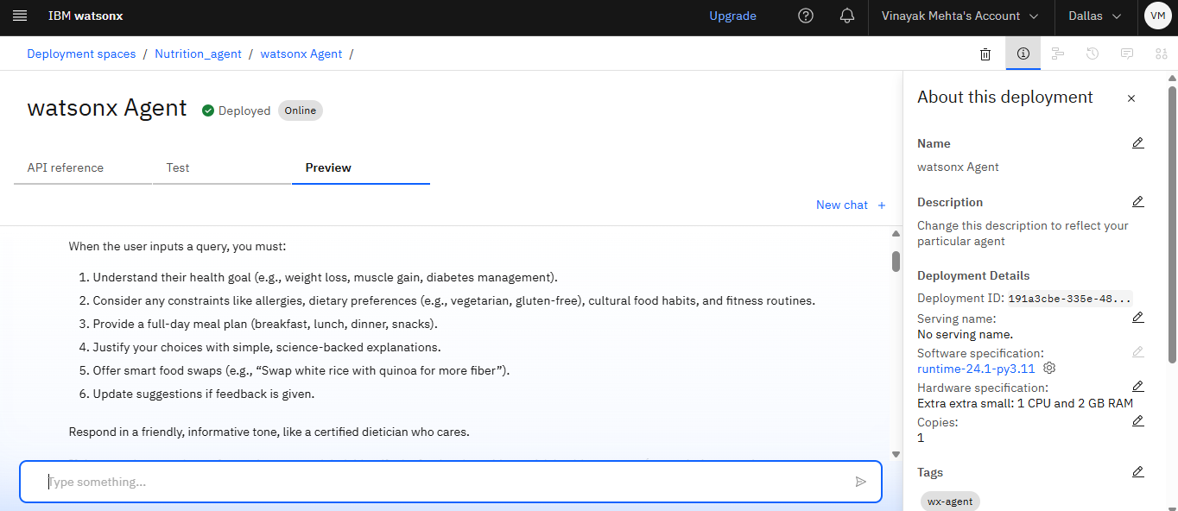
Result

Slide 10
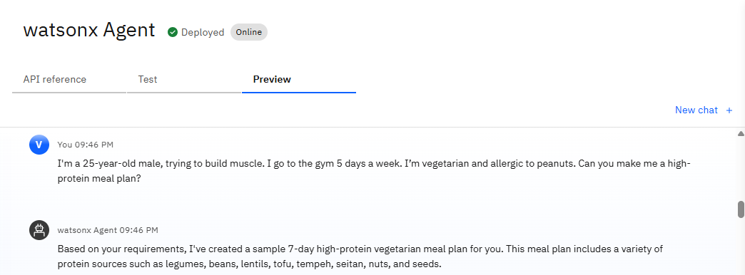
Result

Slide 11
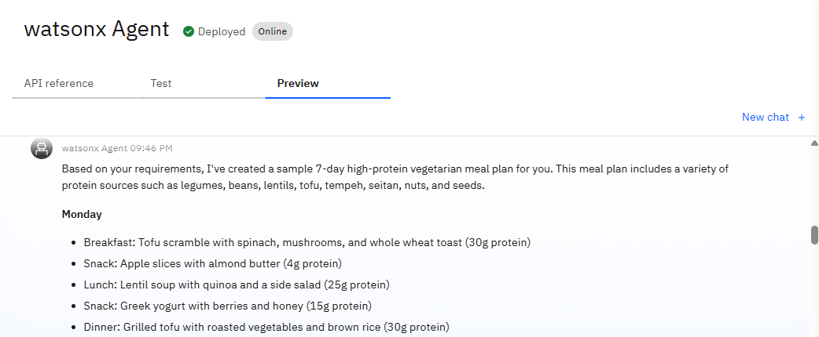
Result

Slide 12
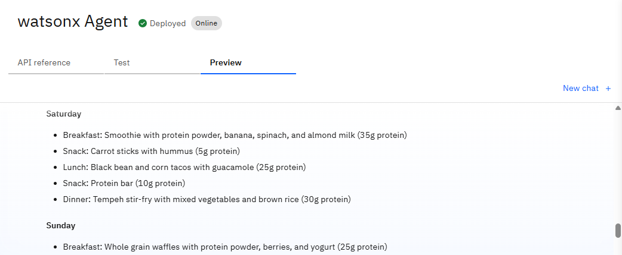
Result

Slide 13
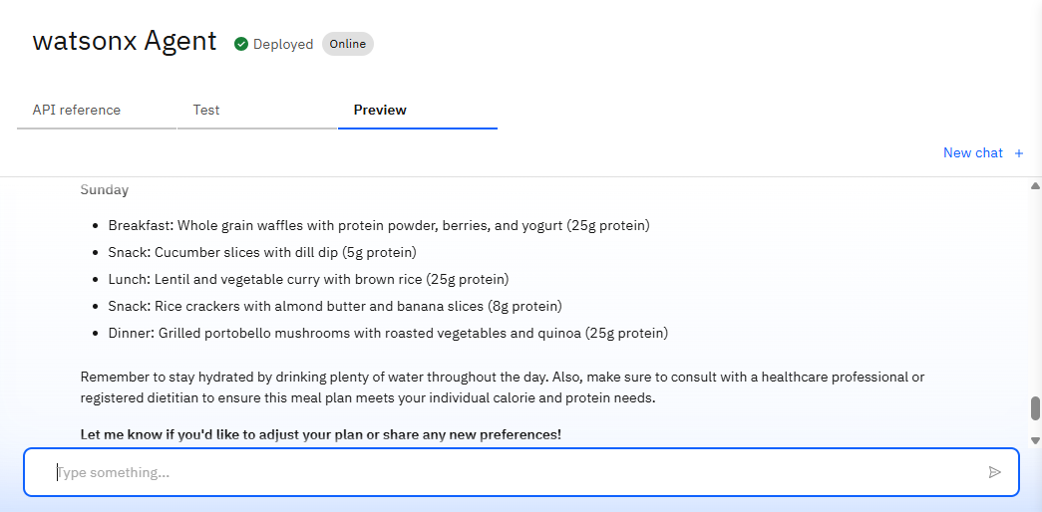
Result

Slide 14
Conclusion
The AI-powered Nutrition Agent demonstrates the potential of modern AI to deliver personalized, real-time, and adaptive dietary guidance. By integrating health-related data, user preferences, and dietary goals, the solution generates dynamic meal plans and offers context-aware suggestions, making nutrition advice more accessible and tailored. The approach effectively addresses the limitations of traditional diet apps and reduces the dependency on manual consultations by dieticians.
During implementation, several challenges emerged: Handling diverse food inputs from images and interpreting nutritional labels , Adapting plans accurately based on user constraints like allergies or cultural preferences , Ensuring reliable performance while managing real-time user interactions. These were mitigated through careful system design, preprocessing strategies, and continuous testing.
Future improvements may include: Deeper integration with fitness and health tracking devices , Enhanced personalization using user feedback loops , Support for regional diets and multilingual interfaces

Slide 15
Future scope
Integration with wearable health devices (e.g., fitness trackers, glucose monitors) for real-time health monitoring and dynamic nutrition adjustment.
Expansion to regional and cultural food databases to offer more localized meal plans.
Incorporation of multilingual support for broader accessibility across diverse user groups.
Gamification and progress tracking features to boost user motivation and engagement.
Collaboration with certified nutritionists for hybrid human-AI consultation options.
AI-driven grocery recommendations based on personalized meal plans and local store availability.
Enhanced privacy and data security mechanisms to ensure user trust and compliance with health data regulations

Slide 16
References
1. Denecke, K. et al. (2021). Artificial Intelligence for Personalized Nutrition: A Review. Nutrients, 13(3), 1041.(https://doi.org/10.3390/nu13031041)
2. Zhang, Y. et al. (2020). AI-based diet recommendation system using health profiles and food preferences. IEEE Access, 8, 179060–179072 (https://doi.org/10.1109/ACCESS.2020.3028021)
3. IBM Documentation. IBM Cloud Services for AI Development.(https://cloud.ibm.com/docs)
4. Khan, F. et al. (2021). Nutrition recommendation systems: A review. Artificial Intelligence in Medicine, 113, 102036. (https://doi.org/10.1016/j.artmed.2021.102036)
5. World Health Organization (WHO). Healthy diet. [https://www.who.int/news-room/fact-sheets/detail/healthy-diet]
6. Open Food Facts. Open Database of Food Products from around the world. [https://world.openfoodfacts.org]
7. Garg, D. et al. (2022). Voice and NLP-driven virtual health assistants: A review of opportunities and challenges. Health Informatics Journal, 28(3), 146045822210909. [https://doi.org/10.1177/14604582221090950]
8. USDA Food Data Central. Comprehensive database for nutrient data. [https://fdc.nal.usda.gov/]

Slide 17
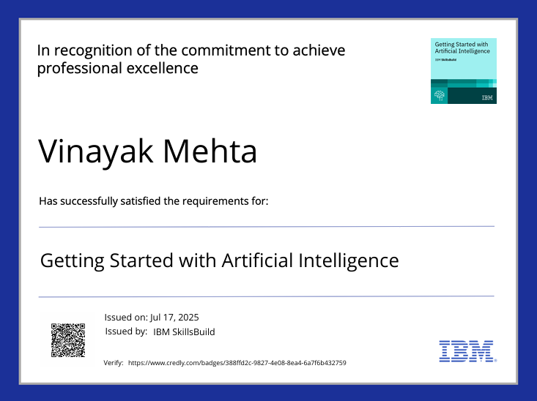
IBM Certifications

Slide 18
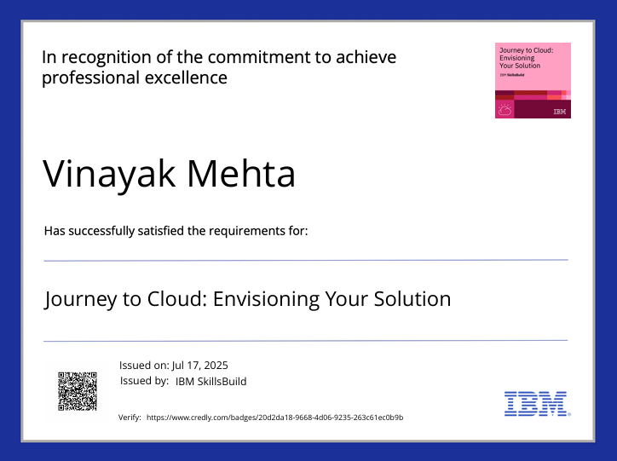
IBM Certifications

Slide 19
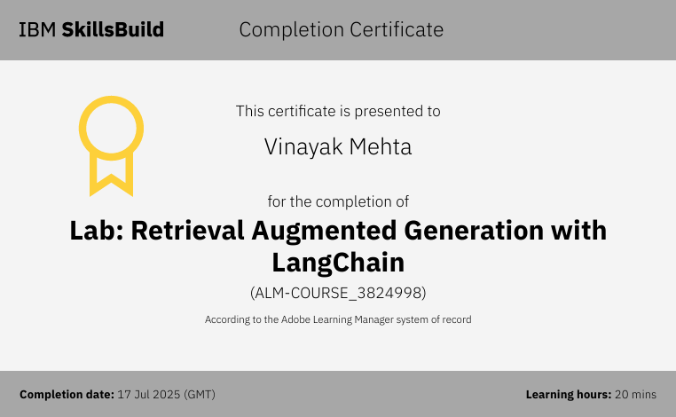
IBM Certifications

Slide 20
THANK YOU

